Slide 1
Hello Everyone
The More The Engagement Of People, The Greater The Economy
Let’s See Some Statistics

Slide 2
UNEMPLOYEMENT RATE OF BANGLADESH IN THREE YEARS DUE TO COVID 19
4.2%
5.3%%
5.4%
IN 2019
IN 2020
IN 2022
ACCORDING TO THE TRADING ECONOMICS

Slide 3
UNEMPLOYEMENT RATE OF STUDENTS IN BANGLADESH
66%
47%
NATIONAL UNIVERSITY
PUBLIC UNIVERSITY
ACCORDING TO THE BANGLADESH INSTITUTE OF DEVELOPMENT STUDIES

Slide 4
STRUGGLES OF STUDENTS IN FINDING JOBS IN BANGLADESH
97%
2.7M
DON’T GET ANY HELP
FROM THEIR UNIVERSITY
TO GET A JOB
ADDED TO JOB MARKET EVERY YEAR
ACCORDING TO THE BANGLADESH INSTITUTE OF DEVELOPMENT STUDIES

Slide 5
UNEMPLOYED IN BANGLADESH DUE TO COVID-19
7.2M
LOST JOB DUE TO COVID-19
ACCORDING TO THE DAILY STAR

Slide 6
UNEMPLOYEMENT RATE OF PEOPLE AND GRADUATES IN SOUTH ASIAN COUNTRIES DUE TO COVID-19
4.3% PEOPLE
33% GRADUATES
4.7% PEOPLE
28% GRADUATES
INDIA
PAKISTAN
4.6% PEOPLE
20% GRADUATES
NEPAL

Slide 7

World’s Perspective
The Covid-19 has led to the loss of
255 Million
Full Time Jobs
According to the International Labor Organization

Slide 8
WORKING-HOUR, EMPLOYMENT AND LABOR INCOME LOSSES IN 2020
Employment Losses
Shift to Unemployment
144 Million
33 Million
≈ 50% of total working-hour losses
Shift to Inactivity
Working hour losses
81 Million
In 2020
8.8%
Working Hour Reduction within Employment
255 Million FTE*
≈ 50% of total working-hour losses
Labor income loss (before income support)
(US$3.7 trillion, or 4.4% of 2019 GDP)
* FTE: Full‑time equivalent jobs (assuming a 48‑hour working week)
Source: ILO Monitor: COVID-19 and the world of work

Slide 9
AFTER GOING THROUGH A MARKET RESEARCH WHICH INCLUDES 230+ PEOPLE RESPONSES
83.4%
84%
92%
INTERESTED IN PROVIDING ODD JOB SERVICES
INTERESTED IN PROVIDING
ODD JOBS
WILLING TO HAVE A PLATFORM
So, the world is desperately in need of a business module that has the potential to create an instant scope of employment for this chunk of people

Slide 10
Introducing
REACH
Hire as You Desire

Slide 11



VISION
TO HELP PEOPLE UTILIZE THEIR INNATE SKILLS, HOUSEHOLD AND TECHNICAL SKILLS AND THEIR PASSION TO PROVIDE SERVICES IN ORDER TO LET THEM GAIN A MONETARY BENEFIT OUT OF IT
OUR EXPEDITION
MISSION
TO CREATE A VIRTUAL PLATFORM WHERE PEOPLE CAN FIND WORKERS TO DO ANY OF THEIR ODD JOBS
GOAL
TO RECRUIT AND ENSURE THE MAXIMUM ENGAGEMENT OF PEOPLE BY LETTING THEM USE ALL OF THEIR SKILLS AND WILL TO PROVIDE SERVICES

Slide 12
HOW REACH COMES INTO PLAY
1
Offers customized odd jobs where people of any age, sex, educational background can apply
2
Helps people get into Jobs that might require no experience at all
3
Helps people gain a monetary benefit by utilizing their existing typical Household/handyman skills
4
User Friendly
5
Favors the Unemployed
6
Broadens the working domain of an individual

Slide 13
Prototype and Other Demo link
The google drive link of basic prototype and initial phase of the App REACH in (Also attached in same folder)
https://drive.google.com/file/d/13sqJbKZ8Xw_oAMV365FFx0epx-9rtwRD/view?usp=share_link

Slide 14

REACH
HOME PAGE
JOB POST
ABOUT
LOGIN OR CREATE ACCOUNT
CONTACT US
BROWSE SKILLED JOBS
CHOOSE CATEGORY
SPECIAL SKILLED JOBS
ELECTRICAL
DATA ENTRY
COOK/CHEF
ELECTRICIAN
DATA ENTRY
TYPE WRITING
GARDENING
CRAFTING
TAILORING
COOKING
TYPE WRITING
GARDENING
CRAFTING
TAILORING
PLUMBING
LABOR
CARPENTRY
TECHNICIAN
TYPE WRITING

Slide 15

REACH
HOME PAGE
JOB POST
ABOUT
LOGIN OR CREATE ACCOUNT
CONTACT US
BROWSE UNSKILLED JOBS
CHOOSE CATEGORY
JOBS THAT REQUIRE NO EXPERIENCE
COOK/CHEF
ELECTRICIAN
DATA ENTRY
TYPE WRITING
GARDENING
CRAFTING
TAILORING
VOLUNTEER
LEAFLET DISTRIBUTOR
SHOP KEEPER
SECUIRITY GUARD
GYM ASSISTANT
CLEANER
BILLBOARD INSTALLER
PET WALKER
SHOPPING ASSISTANT
WAITER
DELIVERY BOY
PROFESSIONAL CARE GIVER

Slide 16
WHY REACH IS DIFFERENT FROM OTHERS?
1
FAVORS THE UNEMPLOYED
2
LETS PEOPLE EXPLORES INNATE SKILLS
3
OFFERS CUSTOMIZED ODD JOBS
4
ENSURES THE SAFETY BY KEEPING TRACK
OF THE AUTHENTIC DETAILS OF THE EMPLOYEES

Slide 17
MARKET DEMAND ANALYSIS
AFTER GOING THROUGH A MARKET RESEARCH WHICH INCLUDES 230+ PEOPLE RESPONSES
83.4%
60.3%
71.8%
INTERESTED IN PROVIDING ODD JOB SERVICES
INTERESTED IN PROVIDING SKILLED ODD JOB SERVICES
INTERESTED IN PROVIDING CUSTOMIZED ODD JOB SERVICES
ACCORDING TO OUR PERSONAL SURVEY

Slide 18
MARKET DEMAND ANALYSIS
AFTER GOING THROUGH A MARKET RESEARCH WHICH INCLUDES 230+ PEOPLE RESPONSES
ACCORDING TO OUR PERSONAL SURVEY
Google Form Link: https://docs.google.com/forms/d/1NMIq-n4eApGx9ajjEC7BZQhK9NbvM8TokLF61ojBooo/edit#responses

Slide 19
PLATFORM DEMAND
AFTER GOING THROUGH A MARKET RESEARCH WHICH INCLUDES 230+ PEOPLE RESPONSES
ACCORDING TO OUR PERSONAL SURVEY

Slide 20
Reach: Business Model Canvas
Key Partners
Key Activities
Value Proposition
Customer Relationship
Customers’ Segment
Worker
Community
Needy People
Application and Website development and design mode
Advertisement
Consultation
Database Management
Offers customized odd jobs where people of any age, sex, educational background can apply
Via Social Media
Dividends’
Via Website
Via App Messaging
Add-ons
Review
Complaints
Suggestion
Key Resources
Channel
Reach envisions a world in which individuals are able to explore their innate household and handyman skills, thereby eradicating classism.
Computer
Staff
Office Space
Internet Access
Data Server
Social Media
Trade Shows
Search Engine
Play Store
Campaign
Cost Structure
Revenue Stream
Development Cost Maintenance
Marketing Grooming sessions
Connection Fee Google AdSense Premium Service Charge

Slide 21
Total Income
Annual Revenue via connection Fees
(Estimated)
Rating | Users Daily | Connection Fee | Monthly | Annual Income | Total Income
5 Star | 1000 | 30 BDT | 30,000 BDT | 3,60,000 BDT | $13,650
4 Star | 2500 | 20 BDT | 50,000 BDT | 6,00,000 BDT
1-3 Star | 2000 | 10 BDT | 20,000 BDT | 2,00,000 BDT
Annual Income via Premium Services
(Estimated)
Pack | Users | Basic Fee | Income | Annual Income | Total Income
Monthly | 1000 | $5 | $5,000 | $60,000 | $2,30,000
Half-Yearly | 2000 | $20 | $40,000 | $80,000
Yearly | 3000 | $30 | $90,000 | $90,000

Slide 22
Annual Revenue via Google AdSense
(Estimated)
Table of Content |  |  |  |  |  |  |  | Total Revenue
 |  |  |  |  |  |  |  | $204400
Visitors Per day |  |  | 10k | Click Ads Revenue Per day | $400 | Ads Revenue Per day | $560
Pages Visited | 8 | Click Ads Seen by Visitors per day | 16
Ads per page | 5
% of click Ads | 0.4
CTR |  |  | 0.5%
CPC |  |  | $0.5
Visitors Per day |  |  | 10k | Impressions Revenue Per day | $160
Pages Visited | 8 | Ads Seen by Visitors per day | 16
Ads per page | 5
% of Impression Ads | 0.4
CPM/1000 |  |  | $1/1000
1 Year or 365 Days |  |  |  |  |  |  | 365
*For displaying ads with AdSense for content, publishers receive 68% of the revenue in connection with service
*For AdSense for search, publishers receive 51% of the revenue in recognized by Google

Slide 23
POST-LAUNCH HYPE BUZZ
APP AUDIT
REVIEW GENERATION
COMPETITIVE ANALYSIS
IN-APP ADVERTISEMENT
IDENTIFICATION OF USP
SOCIAL MEDIA CAMPAIGN
FEEDBACK AND RECOMMENDATION
UPSELLING STRATEGIES
LAUNCH STRATEGY CONSULTATION
CONTEST
CREATION OF
MARKETING ROADMAP
AND GIVEWAY
REACH MARKETING
PRE-LAUNCH HYPE
STRATEGIC LAUNCH
TEASER
VIRAL PROMOTION
REACHING TARGET USERS
OPTIMIZATION FOR AN APP STORE SEARCH
CAMPAIGNS

Slide 24
SOCIO-ECONOMIC IMPACT
1
AN OPPORTUNITY TO MINIMIZE CLASS DIFFERENTIATION
2
ENGAGEMENT OF WIDE ARRAY OF PEOPLE IN VIVID JOBS
3
ACCESS TO BETTER GROMMING FOR THE UNPRIVILEDGED

Slide 25
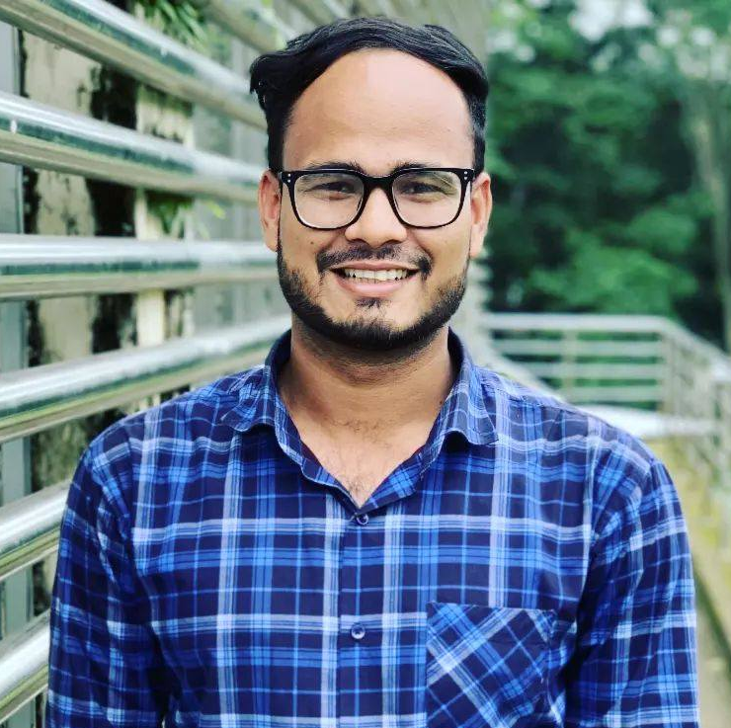
About My Self
Md Sadman Hafiz
Dept of Software Engineering,(3rd Year)
CEO
CTO
Shahjalal University of Science and Technology, Sylhet, Bangladesh
A Group Of Three Students Who Believe
Email:hafiz.sust333@gmail.com
CEO
CTO
Github:https://github.com/Hafiz-sustswe
linkedIn: https://www.linkedin.com/in/sadman-hafiz-848416200/

Slide 26
THANKS
KEEP APPRECIATING

